Slide 1
Chapter 1 “The State of Virtualization”
Virtual and Cloud Computing Security

Slide 2
Outline
Virtualization
Motivations and Advantages
First Virtual Machine
Problems and Solutions
Xen philosophy
Xen architecture and configuration

Slide 3
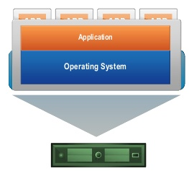
What is Virtualization
Pretending to be two (or) more of the same system.
Definition:
In computing, virtualization refers to the act of creating a virtual (rather than actual) version of something, including virtual computer hardware platforms, operating systems, storage devices, and computer network resources.
Traditionally the OS and the applications were tightly coupled to the hardware they were installed on.
Virtualization breaks the link between operating systems and physical hardware

Slide 4
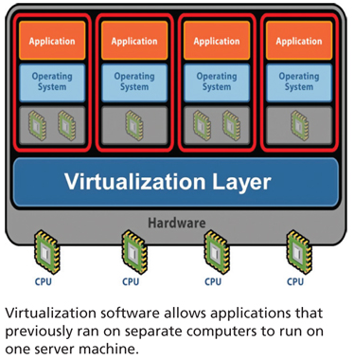
Motivations of Virtualization
The basic motivation for virtualization is the same as that for multitasking operating systems; computers have more processing power than one task needs.
The second generation was programmable; these computers could do one task at a time and then do another task.
Eventually, the hardware became fast enough that a machine could do one task and still have spare resources.
Multitasking was one of the motivation to virtualization. This allowed # of processes to run on single CPU by utilizing its full capacity. Multitasking made it possible to take advantage of this unused computing power.

Slide 5
Advantages
Cloning @ low cost :
A clone is a copy of a virtual machine. You can do anything with a clone that you could with the original virtual machine. Installing a guest operating system and applications can be time consuming. By cloning a virtual machine, you can easily deploy many copies of a fully configured virtual machine, without the need to install the same operating system and applications in each copy.
a. Full clone, is an independent copy of a virtual machine that shares nothing with the parent virtual machine after the cloning operation. Ongoing operation of a full clone is entirely separate from the parent virtual machine.
b. linked clone, is a copy of a virtual machine that shares virtual disks with the parent virtual machine in an ongoing manner. This conserves disk space, and allows multiple virtual machines to use the same software installation.
Migration to different host if the parent host needs to be upgraded or is experiencing faults.
Reduction Power & Cost, since multiple servers are consolidated into virtual machines.
Portable, stage of virtual machine can be saved onto USB drive or any other portable device.
virtual machine provides greater degree of isolation than a process in operating system.

Slide 6
Forms of Virtualization
CPU Virtualization
Basic technique: direct execution
As long as it is executing unprivileged instructions the virtual machine (guest OS + applications) executes hardware instructions directly.
If the guest OS tries to execute a privileged instruction the CPU traps to the VMM which executes the privileged operation
Privileged instructions,
instruction that can be executed in either supervisor or ring-0 mode.
Instructions that trap if the processor is in user mode, and do not trap if it in supervisor mode, i.e upon encountering a privileged instructions, processor switches to kernel mode, and operating system performs a service.
2. Control sensitive instructions
Those that attempt to change the configuration of system resources such as updating virtual to physical memory mappings (or) mode of processor.
3. Behavior sensitive instruction
These instruction behave based on configuration of resources (or) the processors state.

Slide 7
Forms of Virtualization(2) “I/O Virtualization“
Operating system requires I/O devices other than CPU like main memory and set of devices.
To simplify I/o, privileged VMs assigned to each hardware I/o device: “driver domains”
domains = virtual machines
Driver domains run physical device drivers – Interrupts still handled by VMM before being sent to appropriate driver domain
Regular VMs (“guest domains”) run simple virtual device drivers
- communicate with physical device drivers in driver domains to access physical I/o hardware.
Data sent between guest and driver domains is by page remapping.

Slide 8
I/O Virtualization - IOMMU
IOMMU- Input output memory management unit
Similar to MMU(Memory management unit) which maps physical to virtual address space but the difference is that IOMMU performs for Devices where as MMU does this for applications.
IOMMU allows pages of real address space to be mapped to device address space.
Without IOMMU the devices are limited to accessing the bottom of the 4GB physical memory, which can cause problems during the mmap system call or virtual memory.
Page faults that are handled without IOMMU are serviced very slowly as the device drivers can only use the bottom part of physical memory.

Slide 9
First Virtual Machine
The first machine to fully support virtualization was IBM’s VM (System/360) project.
Idea of system/360 was to provide stable architecture and upgrade path to IBM customers where variety of machines were produced with this architecture.
Consolidating system/360 machine was one of the key idea where multiple S/360 minicomputers are consolidated to a S/360 mainframe computer assuming that mainframe would also provide same features.
With this idea, each minicomputer would simply be replaced with a virtual machine which would be administrated in exactly the same way.

Slide 10
Problems with X86
80386 was the first computer designed with virtualization in mind. The main goal was to allow multiple DOS applications at once.
DOS was a 16bit operating system, with 16bit applications on 16bit CPU.
80386 had a 8086 virtual mode which allows an operating system to provide an isolated 8086 environment to older programs.
Since it was assumed that future operating system would natively support multitasking hence it was not needed to add a virtual 80386 mode.
Later it was observed that, even without this mode, processor would be virtualizable since control sensitive instructions are a subset of privileged instructions.
I.e., instructions that modifies the configuration of resources in system will either be executed in privileged mode or trap if it isn’t.

Slide 11
Solutions
X86 is difficult to virtualize because some privileged instructions simply fail silently, rather than raising a trap. Although X86 was hard to virtualize but due to its popularity in business use it lead to wide selection of business systems.
Due to large potential returns from delivering a working virtualization solution for X86, efforts have been invested on the limitations and solutions have been proposed.
X86 virtualization approaches
1. Binary Rewriting
2. Para virtualization
3. Hardware-Assisted Virtualization

Slide 12
Binary Rewriting
This inspects each basic blocks and rewrite privileged instruction i.e., each instruction stream be scanned by the virtualization environment and privilege instructions are identified. These are rewritten to point to their emulated versions.
These run multiple unmodified guest OS.
Ex: VMware, Virtual PC, qemu
Para Virtualization
Technique that presents a software interface to virtual machines that is similar but not identical to that of underline hardware.
OS and device drivers are “Aware” that they are being used in virtualized environment.
This type of virtualization involves modifying the OS kernel to replace non-virtualizable instructions with hyper calls that communicate directly with virtualization layer “hypervisor”.
This doesn’t support unmodified OS. It modifies the guest OS to cooperate with the VMM.
Ex: Xen, L4, Denali.

Slide 13
Hardware-Assisted Virtualization
Hardware assisted virtualization is a common name for two independent but very similar technologies by Intel and AMD which are aimed to improve the processor performance for common virtualization challenges like translating instructions and memory addresses.
It is a way of improving the efficiency of hardware virtualization. It involves employing specially designed CPU’s and hardware components that help improve the performance of a guest environment.
X86 doesn’t have full set of instructions that can support concept of virtualization. Few changes are made to Intel and AMD so that they could support virtualization. The changes would be
Both AMD and intel have added set of instructions that makes virtualization considerably easier for X86.
Hypervisor and VMM load at Ring-1.

Slide 14
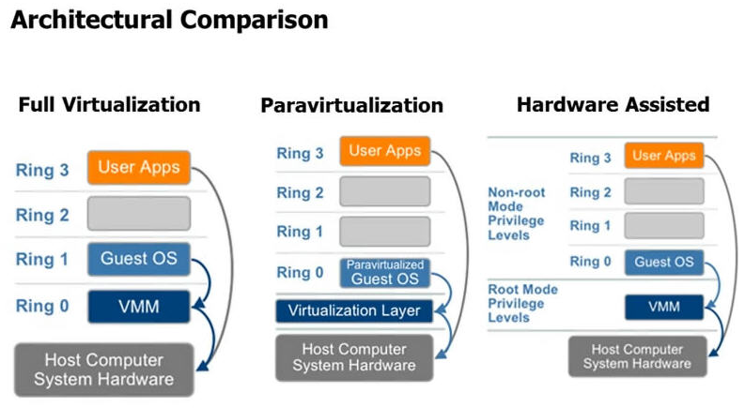

Slide 15
Hardware Requirement for Virtualization
The architectures that support virtualization would need to ensure that processors ability, management of resources, memory access should be monitored.
Some of the leading example include, Intel & AMD.
These features will enhance processor ability to create and manage resources for physical assets like memory access and data transfer across I/O.
Intel, uses VT-x with EPT & Vt-d for virtualized I/O.
Vt-x, probably the best recognized extensions adding migration, priority and memory handling capability.
Vt-d, adds virtualization support to INTEL chips that can assign specific I/O devices to virtual Machine.
AMD, uses RVI(Rapid Virtualization Index) & TLB (Translation Lookaside Buffer).

Slide 16
Xen Philosophy
Xen is a virtualization tool which can run help run many virtual machines on a single system.
Less is more: Xen runs at a very high level of privilege – above even the operating system.
Any bug in the Xen can compromise every virtual machine running on a machine.
To maintain flexibility, Xen doesn’t enforce mechanisms for communicating between domain instead provides simple mechanisms, such as shared memory for the guest OS to communicate using this.
As a result Xen relies on Domain 0 features for the ease of administration.

Slide 17
Xen Philosophy
Separation of Policy and Mechanism: Xen hypervisor implements mechanisms, but leaves policy up to the Domain 0 guest.
Domain 0 hosts the application level management software.
The high level mechanisms such as ring buffers, that are used for passing requests and responses between domains for supporting I/o are not enforced in the code which makes the Xen system very flexible.

Slide 18
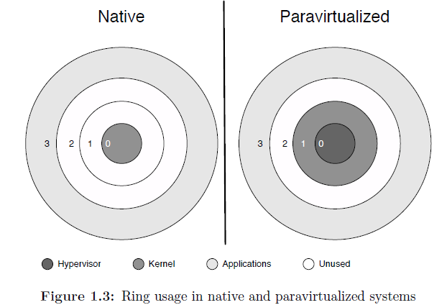
Xen Architecture
Xen resides in between OS and hardware, and provides a virtual environment in which a kernel can run.
Components of system involving Xen architecture are Hypervisor, kernel, user space applications.
Kernels running on Xen architecture are no more on ring 0 and their position is shifted to different rings based on type of platform.

Slide 19
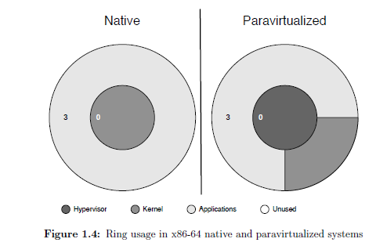
Xen can access to memory allocated to applications that run in ring 3 but this is been protected from other applications and kernels. Like wise hypervisor in ring 0 is protected from kernels in ring 1 and applications in ring 3.
In absence of ring 1 & 2 it was necessary to modify Xen to put the operating system in ring 3, along with applications.

Slide 20
Role of Domain 0
Purpose of hypervisor is to allow guests to run in environments which are popularly known as domains.
These domains encapsulate a complete running virtual machine.
When Xen boots up, first thing it does is to load the Domain 0 guest kernel environment.
Domain 0 has the highest privileges since it is the first guest to run and other domains are referred as domain ‘U’, which means underprivileged.
Domain 0 is very important to Xen system because it provides all the device drivers and user interfaces. Operating systems and user space tools in domain 0 will provide these features.
Linux is the most popular operating system used by Xen developers.

Slide 21
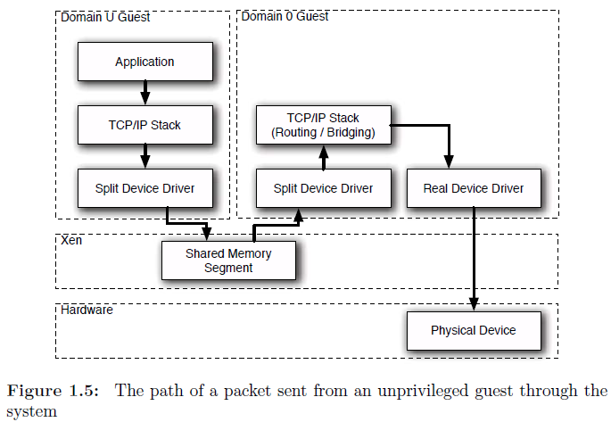
When a packet is transferred by an application running on ‘domU’ guest.

Slide 22
Xen provides a simplified interface to either physical/split network devices which will be easy for people porting systems to Xen. Three common components to any driver would be
1. Split driver:
It moves data fro domU to dom0 guests, usually using ring buffers in shared memory.
2. Real driver:
This already exists in dom0 Operating systems hence it is not consider to be part of Xen.
3. Multiplexer, this may or may not exist. This is provided by other sources like in networking situations, firewall component of network stack provides this functionality.
Domain 0 provides user interface to hypervisor.
Xend, xendstored in dom0 provide important features to the system.
Xend provides an administrative interface to hypervisor, allowing a user to define policy.
XenStore, provides back-end storage.

Slide 23
Unprivileged domains
domU is restricted, cannot access the hardware directly.
domU guest needs only to implement one driver for each device category.
domU guests can be any arbitrary number on a single machine.
The migration of domU guests depends on Xen configuration.
Tightly coupled guests to hardware cannot be migrated.
For security reasons, it is advisable to do as little as possible in Dom0.
domU should not be allowed to access the system hardware on platfoms without IOMMU.

Slide 24
Xen HVM (Hardware Virtual Machine)
Earlier days x86 architecture doesn’t have a full set of instructions to implement virtualization so, the focus of xen hypervisor is to implement paravirtualization.
Recent x86 chips doesn’t have this problem so xen started to support unmodified guests.
Able to run un-modified (no para-virtualization) operating systems. This implementation is known as a hardware virtual machine.
HVM differ from paravirtualized guests in the following ways.
Boot time
Hypercalls() – CPUID instruction makes guest access the virtual machine specific register and access the hypercall page.
Virtual PCI device that exports hypervisor functionality to the guest.

Slide 25
Xen Configuration:
A simple Xen configuration is to run just a single dom0 guest and nothing else, where Xen acts as a simple hardware abstraction layer.
Xen configuration has typically at least 1 domU guest.
Hardware is controlled by the host in the Domain0 which is not always ideal.
Reason being the bugs in a certain device can crash the dom0 kernel and eventually crashing all the guests on the system.
Beneficial to always isolate the drivers in its own domain.
IOMMU can prevent the buggy driver from interfering from the other guests of the system.

Slide 26
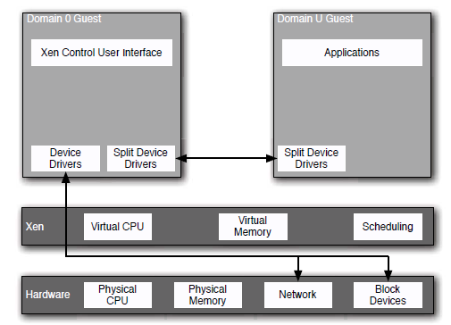
Xen Configuration: (2)

Slide 27
Xen configuration showing driver isolation and an unmodified guest
Xen is used for backward-compatibility by running a legacy operating system concurrently with a new system, it is likely that running an unmodified guest is going to be required.
An unmodified guest is a HVM guest in this case.
In this situation, unmodified guests will not use the split device drivers directly.
Instead, they will use emulated devices run from Domain 0.

Slide 28
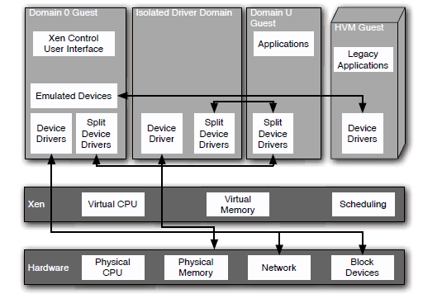
Xen configuration showing driver isolation and an unmodified guest (2)

Slide 29
Single node in a clustered Xen Environment
In a clustered environment, to balance the load on the system we can dynamically redistribute the guests to use the systems in the cluster.
Typical configuration can have a single file server mounted over NFS for each of the clients, and a single router handling external routing.
None of the guests would then depend on the local block device drivers and hence can be migrated between the nodes easily.
In this configuration individual nodes do not even possess a local block device, simplifying cluster costs.
Xen and the Domain 0 guest would be booted using PXE, or some equivalent, allowing individual cluster nodes to be replaced whenever they failed.

Slide 30
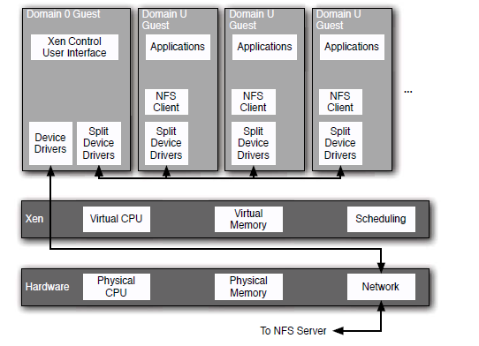
Single node in a clustered Xen Environment (2)

Slide 31
Thank you

